Slide 1


Campus
Connecting
App
Bridging the gap between freshers, seniors, and Professors.

Slide 2
Table of Content
1
About
7
User persona
2
Why the innovation?
8
A Day in a life
3
Current market & competitors
9
Empathy map
4
Competitor Analysis
10
Affinity mapping
5
Research Methodology
11
Journey mapping
6
Key Findings
12
Solution

Slide 3

About
Campus Connection is a mobile app that helps freshers smoothly adapt to college life by connecting them with seniors and professors. It provides a safe, structured space for mentorship, guidance, and reliable information—something existing platforms like WhatsApp or Instagram lack. The app combines social interaction with academic support, making students feel welcomed, confident, and better prepared for their journey.

Slide 4

Vision
To make the transition from school to college smooth, confident, and supportive for every fresher
Mission
To provide personalized mentorship by connecting students with seniors and professors.
To offer verified academic and campus related information in one trusted place.
To create a community of guidance, growth, and collaboration for students.

Slide 5




Why this innovation?
No structured way to connect with seniors or professors.
Freshers feel confused, anxious, and lonely.
Our app solves this gap
WhatsApp/Instagram groups are messy and unorganized.

Slide 6






Current Markets
&
Competitors

Slide 7
Competitor Analysis
Feature | Our Campus App | LinkedIn | Instagram | Facebook | Telegram Groups
Primary Purpose | Mentorship, study help, campus activity guidance | Professional networking, career growth | Social networking, visual content | Community engagement, social networking | Messaging, discussion groups
Target Audience | Students (freshers to seniors), campus clubs | Students, professionals, alumni | Young adults, students | Students, broader community | Students, hobby/interest groups
Core Features | Connect with seniors, clarify doubts, club participation guidance | Connect with mentors, job posts, articles | Stories, posts, messaging | Groups, events, posts, messaging | Group chats, file sharing, polls
Engagement Style | Direct Q&A, event invites, mentorship chats | Messaging, post interactions, endorsements | Likes, comments, stories | Comments, likes, shares, events | Real-time messaging, discussion threads

Slide 8
Feature | Our Campus App | LinkedIn | Instagram | Facebook | Telegram Groups
Strengths | Tailored for campus life, mentorship opportunities, peer guidance | Professional credibility, career networking | High engagement, visually appealing | Large reach, versatile | Privacy, instant communication, flexible groups
Weaknesses | Small user base, limited to campus | Less social, not campus-specific | Not structured for mentoring or guidance | Cluttered, less focused on mentorship | Unstructured learning, lacks formal mentorship
Opportunities for Users | Easy access to senior guidance, academic help, club involvement | Build professional profile, mentorship connections | Connect socially, follow trends | Join student groups, attend events | Join study or hobby groups, exchange resources
Monetization | Ads, premium mentorship features | Premium subscriptions, ads | Ads, sponsored content | Ads, marketplace | None built-in
Privacy / Security | Campus-verified accounts | Professional data visibility | Public/private accounts | Account privacy options | End-to-end encryption for private chats

Slide 9


Research Methodology
Purpose of Research:
Understand fresher’s problems & support needs
Identify features required in Campus Connecting App
Methods Used:
Online Survey among students(128 response)
One-to-One Interviews with seniors & Freshers
Key Insights:
Students need structured mentorship
Verified updates are missing in current platforms
Freshers hesitate to ask doubts publicly

Slide 10
Key Findings
Most Students are uncertain about future career paths.
01
02
Professors are seen as knowledgeable but less approachable.
Key Findings
03
Seniors play big role in informal guidance &placement prep
04
Students rely on WhatsApp/Instagram groups for event updates
05
Communication gaps cause students to miss events & opportunities

Slide 11
USER PERSONA

Slide 12

Riya Trivedi
Bio:
Riya,18 years-old first-year computer Science Student, is excited yet. Overwhelmed city by college life. She want approachable mentors to guide her in academics, clubs, and career choices.
Goals:
Find approachable mentors (seniors/professors).
Get clarity on academics, career path, and college processes.
Adjust smoothly into campus culture (friends, clubs, events). Build confidence to ask questions without fear of judgment.
Explore extracurricular opportunities beyond academics.
Build confidence to ask questions without fear of judgment.
Personality:
"I wish I had a senior who could
guide me without making me feel
dumb."
Introvert Extrovert
Tech-savvy Tech-newbie
Analytical Creative
Passive Active
Age: 18 years old
Gender: Female
Background: Currently passed 12th
Social Media: WhatsApp, Instagram
Frustration:
Needs:
Nervous about approaching professors or seniors directly.
Lost in unorganized WhatsApp/Telegram groups.
Unsure about how to choose electives, clubs, or opportunities.
Hesitant to ask “basic” questions for fear of being judged.
A safe, non-judgmental space to ask doubts.
Easy-to-use platform for connecting with seniors and professors.
Structured guidance (roadmaps, FAQs, resources).
Emotional support and encouragement during the transition.
Hardworking
Curious
Practical
Protective

Slide 13
A Day in Life

Slide 14
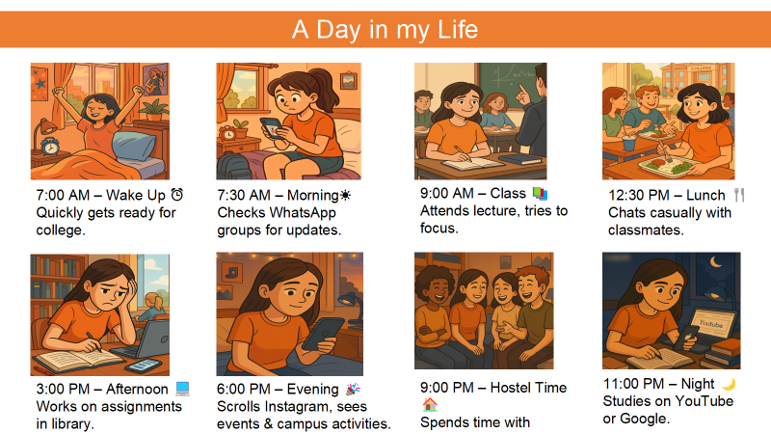

Slide 15
Empathy Map

Slide 16
Who are we empathizing with?
A first-year college fresher (Riya).
Recently joined, adjusting to a new environment.
Role: learner, trying to connect with seniors & professors.
What do they need to do?
Connect with seniors for mentorship & guidance.
Clarify doubts in studies without hesitation.
Learn how to participate in clubs/activities.
1
GOAL
2
3
7
What do they think and feel?
What do they see?
Seniors confidently interacting & managing activities Professors who seem approachable but formal.
Classmates also trying to adjust.
WhatsApp/Instagram flooded with messages.
6
Pains:
Fear of missing out on important updates
Anxiety about asking questions.
Overwhelmed by too many WhatsApp messages.
Loneliness & difficulty in building friendships.
Gains:
Clear, reliable platform to connect with seniors & professors.
Want to be confident & active in class.
Hopes to make good friends.
Dream of excelling academically & socially.
What do they HEAR?
College life is tough at the beginning.
Get involved in activities.
Focus on studies, don’t hesitate to ask.
4
What do they say?
“I’m nervous but excited about college.”
I don’t know how to ask seniors for help.”
I don’t know how to ask seniors for help.”
“Clubs look fun, but I don’t know how to join.”
What Other thoughts and feelings that might motivate Riya’s behavior?
Desire to prove herself in a new environment
Worry about missing out (FOMO) on important opportunities or updates.
5
What do they do?
Scrolls Instagram & WhatsApp for updates.
Attends lectures but hesitates to ask questions.
Tries talking to classmates during lunch.
Messages seniors but waits anxiously for replies.

Slide 17
Affinity Map

Slide 18
Needs
Affinity Mapping
Features
Problems
Guidance from seniors for academics & campus life
Verified information about clubs, events & opportunities
Safe place to ask doubts without fear of judgment.
Students can rate mentors’ helpfulness, ensuring quality guidance.
Easy way to reach professors without hesitation
A supportive community to reduce loneliness
Too many random WhatsApp/Instagram groups → Confusing
Shyness & fear of being judged → Don’t ask questions
Ideas
Private chat + subject/club-based discussion groups.
Notes, past-year papers, recordings & guides shared by seniors/professors.
Career & skill development advice
A safe space to ask “silly” questions
Miss important event updates due to poor communication
Difficult to find the right senior/mentor
Single platform to connect all (freshers, seniors, professors)
Feedback system for mentors/professors
Important alerts for classes, deadlines, events in one place.
students can rate mentors’ helpfulness, ensuring quality guidance.
Professors feel less approachable
Sometimes feel isolated in hostel/campus
Q&A Forum (can post anonymously if shy)
Event calendar + reminders for clubs & activities
Separate tags for Freshers, Seniors & Professors for easy identification.
Tips, peer-support groups & counseling resources for stress management.
Discussion groups by subjects/clubs
Rewards for seniors who actively mentor

Slide 19
JOURNEY MAPPING

Slide 20

Riya the Curious Fresher
Riya is a shy but curious fresher, eager to learn and connect, while adjusting to her new college life.”
Scenario: Riya is a first-year college student, recently joined campus. She feels excited about new opportunities but also nervous and shy about connecting with her seniors, professors, and peers.
Expectations:
Guidance from seniors & professors.
To feel included and confident.
Clear info about academics & activities.
Build friendships and manage time smoothly.
.
CONSIDER
(1st Week)
EXPLORE
(1st Month)
COMPARE
(Settling In)
TEST
(Trying Activities)
NEGOTIATE
(Decision / Balance)
Attends orientation and joins WhatsApp groups.
Sees posts on Instagram about clubs/events.
3. Visits library, explores campus.
4. Scrolls Instagram for events and activities
5. Wonders about joining clubs.
6. Asks seniors about clubs.
7. Checks different activities (sports, cultural, academic).
8. Balances between academics & social life
9. Attends her first club meeting.
10. Tries group study with classmates.
11. Participates in small campus event.
12. Finalizes clubs she likes.
13. Makes 2-3 close friends.
14. Learns to balance time between study & activities.
"This library is so big, I don’t even know where to start."
"That first club meeting was fun, maybe I should go again."
"I’m finally starting to feel comfortable here."
"I hope I don’t get lost in this big campus."
"Which seniors should I trust for advice?"
"I see events on Instagram, but I’m not sure if I should go alone."
"I’m happy I made a few close friends."
"Group study is helpful, but I don’t always understand everything."
"Everyone seems so confident, I feel a bit left out."
"This club looks interesting, but will I fit in?"
"Joining this club was the right decision."

Slide 21
SWOT ANALYSIS
STRENGTH
WEAKNESS
Provides structured mentorship between
freshers, seniors, and professors.
Centralized platform for events, resources, and
guidance.
Builds community & belonging, reduces anxiety
for new students.
Safer & more reliable compared to
WhatsApp/Instagram groups.
Encourages academic + social balance.
Initial adoption challenges (convincing students to shift from WhatsApp/Instagram).
Requires active participation from seniors/professors.
May need strong moderation to avoid misuse.
Limited network effect in early stages(works best when many join).
OPPORTUNITY
THREATS
Growing need for student support systems in colleges.
Can expand to include alumni mentorship & career guidance.
Potential to collaborate with universities officially.
Integration of AI chatbots for instant FAQ support.
Monetization via premium mentorship, workshops, or ads.
Competition from existing social media platforms (WhatsApp, LinkedIn).
If moderation fails → risk of spam or negative experiences.
Student hesitation due to privacy or trust issues.
Colleges might resist adoption if they already have internal systems.

Slide 22
Mind Mapping

Slide 23
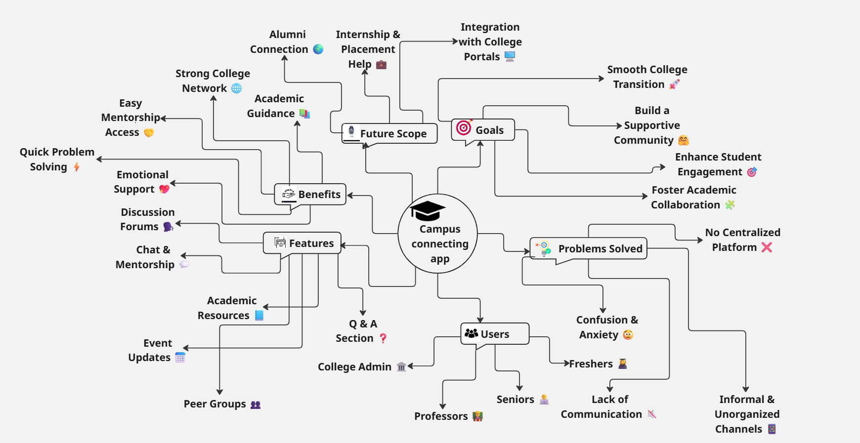

Slide 24
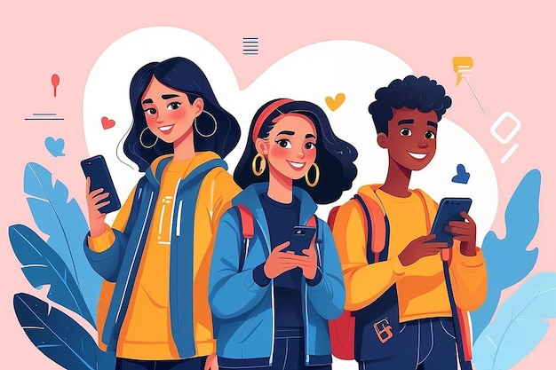
Our Solution
Our Solution A college companion app that helps students
Connect with professors for subject doubts &guidance
Engage with seniors for mentorship &placement prep
Get real-time updates on workshops, events,competitionsGoal
Make college life easier, more connected, and future-ready.

Slide 25
Prototype

Slide 26


Overview
We created a basic interactive prototype of the Campus Connect platform using HTML/CSS and simple navigation features. The prototype demonstrates the key functionalities of the system and visualizes how a student will interact with the platform.
https://namamiraval.github.io/Campus-Connect/
Features Included in Prototype:
Homepage with dashboard-style tiles
Clubs page with join options
Event section placeholder
Sidebar navigation
Announcements section
Simple responsive layout
Clean UI based on modern app design principles

Slide 27
Problem 01 — Lack of Proper Guidance
Roots of causes:
Freshers don’t know: Whom to contact?
How college system works?
Which clubs & opportunities are right?
➡ Results: Confusion + wrong decisions
Solutions
Create a dedicated mentorship program where seniors guide small groups of freshers
Organize orientation workshops about opportunities (clubs, internships, competitions)
Centralized Helpline Desk or online Q&A portal for common queries
Positive Impacts
Freshers make informed decisions early
Quick adaptation to college culture
Higher participation in academic & extracurricular activities
Better career direction from the beginning

Slide 28
Problem 02 — Hesitation & Fear of Asking Doubts
Roots of causes:
Freshers feel: “What if they judge me?”
Anxiety to talk to seniors/professors Avoid asking basic questions
➡ Results: Knowledge gap + low confidence
Solutions
Anonymous doubt-solving platform to ask any question without fear
Friendly peer interaction events to build comfortable communication
Professors & seniors conduct open-office hours and mentorship calls
Encourage a no-judgment environment
Positive Impacts
Improved confidence & communication skills
Smaller learning gaps → stronger academic performance
Healthy student-senior relationships
Feel safer and more connected with the college

Slide 29
Problem 03 — Unorganized Communication
Roots of Causes:
Too many random WhatsApp/Instagram groupsMessages get lost in bulk chats No official verification of updates
➡ Results: Missed deadlines & events
Solutions
One official verified communication platform (app/portal)
Categorized groups: academics, events, hostel, club updates
Push notifications, reminders for deadlines & exams
Approval process for announcements to avoid fake news
Positive Impacts
No important update gets lost
Efficient coordination among students, faculty & clubs
More attendance in events and opportunities
Reduction in stress related to missing deadlines

Slide 30
Problem 04 — Feeling of Isolation
Roots of Cause:
Difficult to make new friendsHostel/campus feels lonely initially
No support system emotionally
➡ Results: Stress, homesickness, low involvement
Solutions
Buddy system: Matching freshers with supportive peers/seniors
Frequent social mixers, sports & cultural events
Mental health support: counseling, open talk circles
Communities based on hobbies, language, region
Positive Impacts
Strong friendships & emotional well-being
Increased campus involvement and enthusiasm
Lower homesickness, anxiety, depression
Sense of belonging + happier college life

Slide 31
Conclusion
College is not just about academics—it’s about growth, opportunities, and guidance and the current gaps leave students confused, disconnected, and underprepared.
Through design thinking research & insights, we identified clear pain points and opportunities and provided solutions for the same.
By implementing this solution, colleges can create an environment where students feel supported, connected, and future-ready.

Slide 32
Thank
You !

